Slide 1

Final Presentation
People Analytics at Seagate: A Strategic Approach to Predict
Voluntary Churn and Optimize the Hiring Process
Group Members
Amandeep Bhardwaj
amandeep.bhardwaj@colorado.edu
Anubhav Dubey
anubhav.dubey@colorado.edu
Sai Arvind Atluri
saiarvind.atluri@colorado.edu
Sandeep Reddy Modugu
sandeep.modugu@colorado.edu

Slide 2

Problem Statement
Enhance Decision-Making: Aim to leverage predictive analytics and machine learning to refine the insights that HR offers to leadership.
Data Diversification: Manage and analyze diverse employee data, from basic employment details to extensive workforce demographics and compensation framework over the years.
Integration and Analysis: Explore effective methods to integrate and clean data from various systems to facilitate comprehensive analysis.
Beyond Excel: Address the limitations of Excel, which can be time-intensive and lacks scalability for dynamic data analysis needs.
Goal: Utilize predictive analytics to identify the voluntary employee turnover and accurately forecast hiring needs, thereby creating a sustainable strategy for talent management.

Slide 3

Data Overview
Fundamental Process:
Navigating data integrity and accuracy is critical in projects aiming to derive meaningful insights from diverse and complex datasets.
1
Common Data Issues:
Datasets often contain errors, inconsistencies, outliers and missing values, which can distort analytical outcomes.
2
Necessity of Data Cleaning:
Data cleaning is essential yet time-consuming, requiring continuous refinement to align with analysis-specific demands.
3
Objective:
Implement a rigorous data cleaning regimen to ensure reliable insights and support informed business decisions.
4

Slide 4
Data Cleaning and Preparation Process
Data Profiling:
Initial exploration to identify quality issues, followed by detailed recording of findings to guide cleaning.
Addressing Missing Data:
Combination of statistical techniques and domain knowledge applied to manage missing data effectively.
Duplicate Identification:
Ensured data uniqueness by identifying and removing duplicate records, documented to maintain integrity.
Normalization & Transformation:
Transformed data to normalize distributions and encode categorical variables, positioning data for advanced analysis.
Feature Engineering:
Used categorical and numerical variables and augmented dataset to enhance analysis, particularly with financial metrics.
Outlier Management:
Detected and treated outliers to ensure data accuracy; employed methods like thresholding.
Quality Assurance:
Rigorous process to ensure data's consistency and reliability post cleaning.
Documentation & Validation:
Documented the final dataset and validated the cleaning processes to align with project objectives.

Slide 5
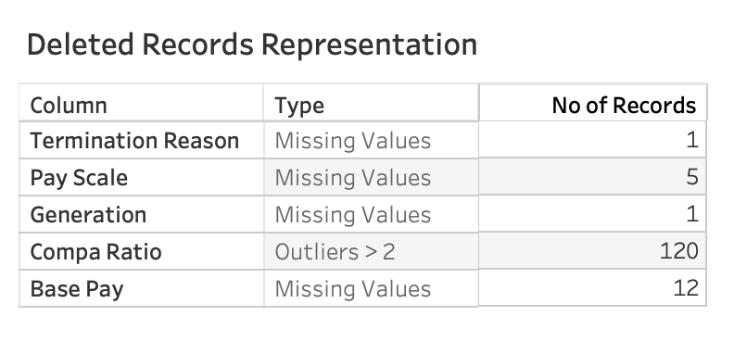
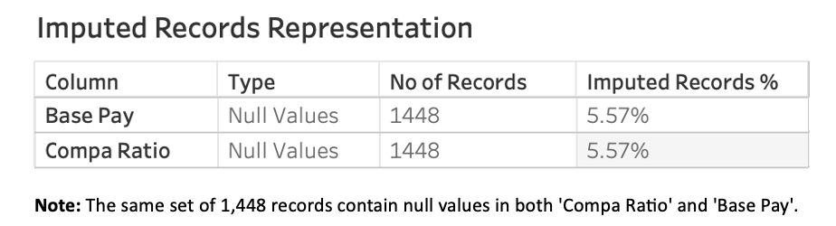
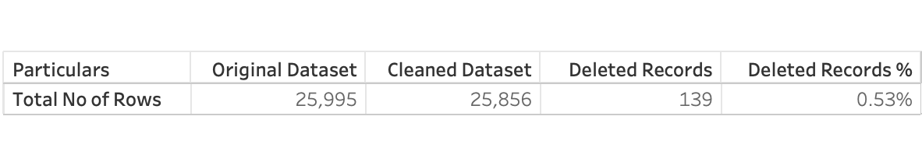
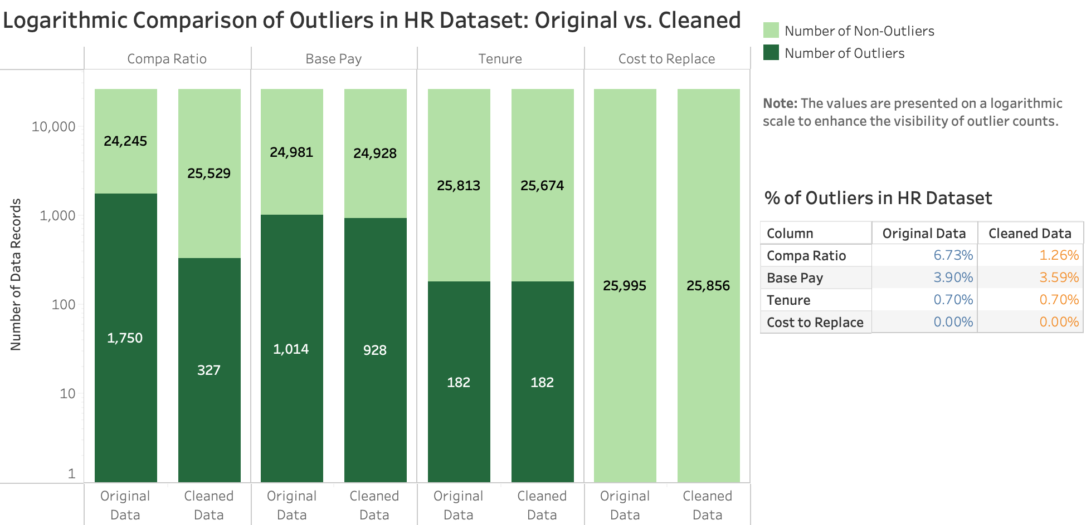
Data Cleaning Overview

Slide 6
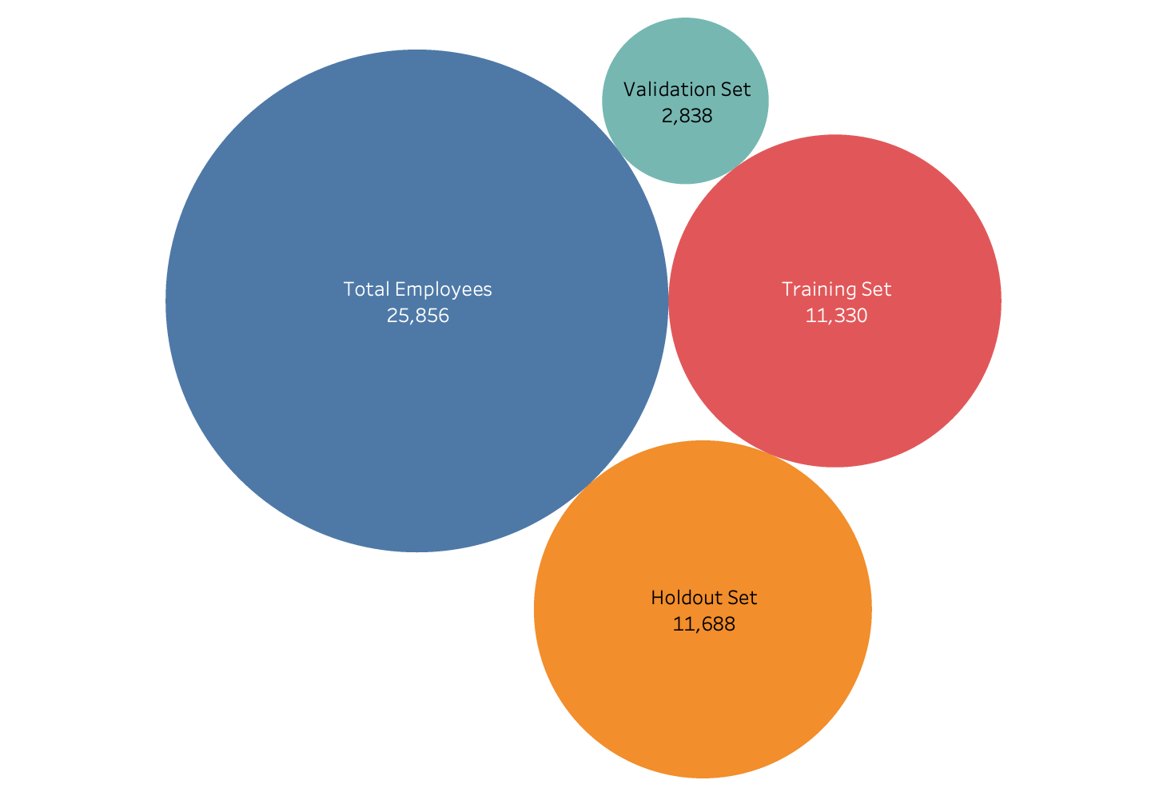
Data Splitting and Setup
• Data Setup & Segmentation: Dataset consists of 25,856 records; segmented into 14,168 terminated and 11,688 active employees for historical and predictive analysis.
• Model Training & Validation: Terminated dataset is split into 80/20 for model training and validation. Active employee data is reserved as a holdout set to test model's real-world efficacy.
• Feature Engineering: Designed features to capture key predictors of employee turnover, focusing on job-related, demographic, and financial factors.
• Model Design: Binary target variable 'Is Voluntary’ is established to focus on voluntary terminations. Excluded ‘Termination Date’, 'Termination Type’ and ‘Termination Reason’ fields for unbiased prediction capabilities.

Slide 7

Random Forest Model
Overview: Utilizes RandomForestClassifier to analyse employee turnover through constructing a multitude of decision trees for robust predictions.
Functionality: Combines numerous independently trained decision trees to address different aspects of the dataset, improving the prediction stability and accuracy through aggregation.
Accuracy & Performance: Achieved an overall accuracy of 76%, confirming its efficacy in classifying types of employee terminations.
Strengths: Known for high accuracy and the ability to handle large datasets with complex feature interactions.
Application: Used to differentiate between voluntary and non-voluntary terminations, aiding in strategic HR decisions.

Slide 8

XGBoost Model
Overview: Employs XGBoost Classifier, a powerful model that utilizes a gradient boosting framework for decision trees, thereby optimizing both speed and accuracy.
Functionality: Integrates rigorous training within a pipeline, including one-hot encoding and missing data imputation, enhanced by isotonic regression calibration.
Accuracy & Performance: Demonstrated superior performance with an accuracy of nearly 78% and a high ROC-AUC Score of 86.7%.
Strengths: Effective in handling varied data types and complex interactions due to its advanced boosting techniques.
Application: Primarily used for distinguishing between voluntary and non-voluntary terminations, enhancing predictive HR strategies.

Slide 9

AdaBoost Model
Overview: Utilizes AdaBoost Classifier to enhance prediction through a sequence of weak learners that focus on challenging cases.
Functionality: Incorporates multiple weak learners to prioritize and correct previous misclassifications, aiming for improved model sensitivity.
Accuracy & Performance: Maintained a solid performance with an accuracy of approximately 74.45%, showcasing reliable predictive capabilities.
Strengths: Excels in iterative model adjustment, focuses on misclassified instances and improves iterations.
Application: Used for identifying patterns indicative of voluntary turnover, crucial for HR intervention strategies.

Slide 10

CatBoost Model
Overview: Employs CatBoost Classifier and tailored for handling categorical data with gradient boosting techniques.
Functionality: Designed for quick, scalable results and high performance, integrates pre-processing for categorical features.
Accuracy & Performance: Showed excellent performance with an accuracy of approximately 77.66%, effectively differentiating between termination types.
Strengths: Optimized for quick, scalable outcomes and exceptional handling of categorical features.
Application: Effectively predicts voluntary terminations, aiding in targeted HR strategies and interventions.

Slide 11
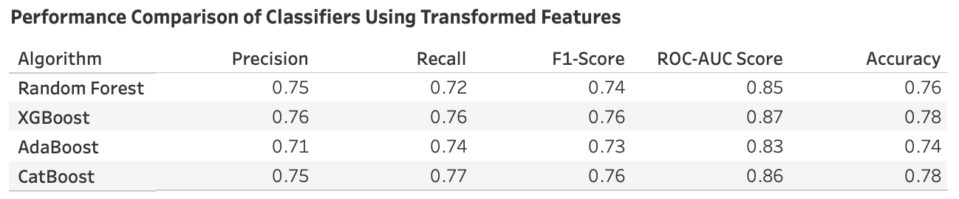
Model Performance Comparison
Evaluation Overview: Comparison of four machine learning classifiers based on transformed features performance.
Precision & Recall: Precision ranges from 0.71 to 0.76, while Recall varies between 0.72 and 0.77, reflecting the classifiers’ validity and coverage.
F1-Score: F1-Scores from 0.73 to 0.76, suggesting a balanced harmonic mean of precision and recall across models.
ROC-AUC Score: ROC-AUC Scores between 0.83 to 0.87 indicate strong discriminative ability to distinguish class memberships.
Overall Accuracy: Accuracy metrics show tight grouping from 0.74 to 0.78, illustrating closely competitive overall performance.

Slide 12

Selecting CatBoost as the Premier Classifier
Performance Excellence: Exhibits high recall and balanced performance metrics; optimal for detecting voluntary terminations.
Feature Handling: Efficiently manages categorical features by reducing pre-processing time and preserving data integrity.
Overfitting Resistance: Demonstrates stable performance, indicating reliable applicability in real-world scenarios.
Operational Efficiency: Offers faster post-training prediction times, vital for real-time application efficiency.
Model Interpretability: Provides transparent feature impact analysis, ensuring compliance with legal and operational standards.
Versatility and Adaptability: Performs well across varying data distributions, ensuring future compatibility.

Slide 13

Predictive Analysis of Voluntary Termination
Feature Processing & Prediction: Categorical along with numerical features from active employees are processed and termination probabilities were predicted.
Risk Assessment: Employees are ranked by predicted risk, identifying the top candidates likely to voluntarily leave.
Optimization & Thresholding: An Optimal threshold is determined from precision-recall analysis, maximizing the F1-Score to flag high-risk employees.

Slide 14
Forecasting Employee Turnover
Historical Trend Analysis: Leverages historical turnover distribution to forecast future voluntary terminations.
Threshold Application: Applies the optimal threshold from model calibration to quantify high-risk employee segments.
Proactive Planning: Predictions enable proactive HR strategies to address potential turnover, improving retention.
Annual Termination Estimates: Provides estimated annual terminations, aiding in workforce planning and talent management.

Slide 15
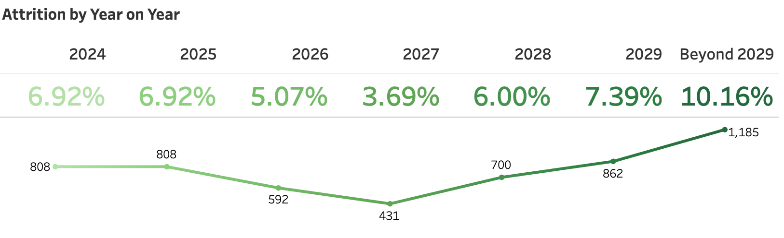
Note: The Attrition rate for 2024, currently at 6.92%, reflects the exclusion of 120 employees i.e. 1.03% who have voluntarily terminated their employment during the current year.

Slide 16
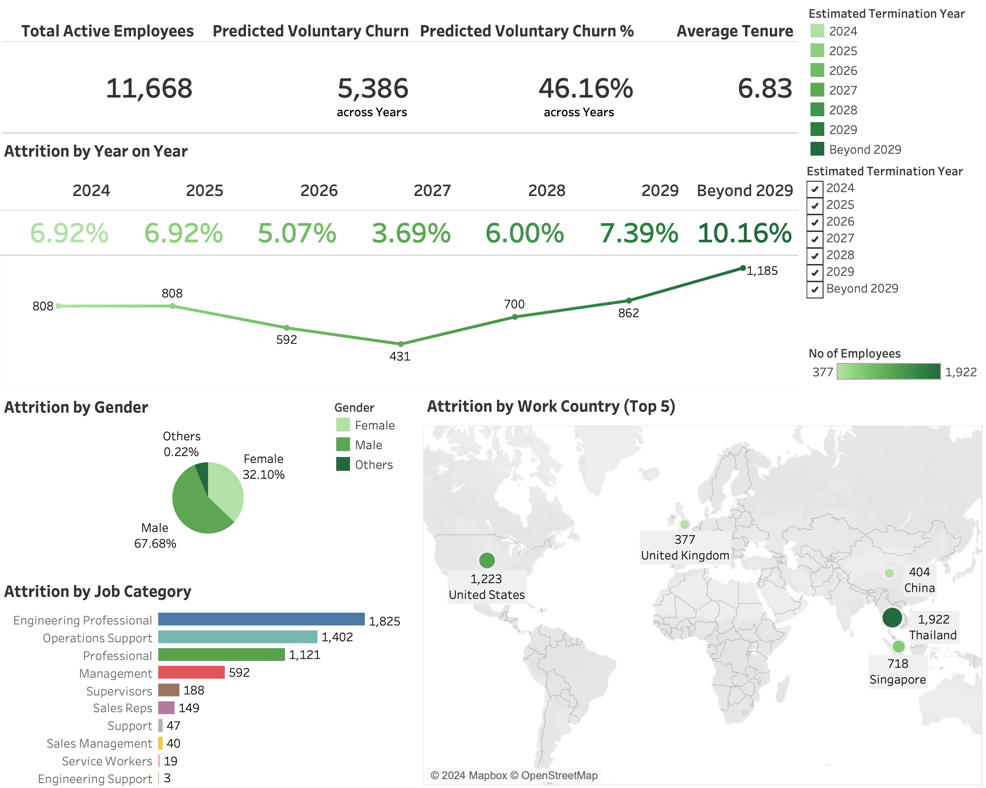
Snippets
Predicts 46.16% voluntary employee turnover in coming years with an average tenure of 6.83 per employee.
Steady early attrition rates, with an increase to 10.16% projected beyond 2029, suggesting the need for retention strategies.
Higher predicted attrition among males and in roles like Engineering and Operations highlight the key demographics for focused retention efforts.

Slide 17

Financial Strategy for Talent Acquisition amidst Voluntary Churn
Churn Cost Projections: Anticipated voluntary turnover of 1,616 employees, with an estimated financial impact of approximately $66.8 million over the next two years, based on salaries, turnover rates, and hiring multipliers.
Comprehensive Hiring Expenses: Allocate budget for recruitment, training, onboarding, and additional incentives such as relocation packages and joining bonuses to ensure competitive hiring practices.
Strategic Budget Utilization: Invest the allocated funds to cover the cost of replacing critical roles and support new positions essential for company growth and sustainability.
Targeted Investment in High-Risk Areas: Prioritize funding for departments and regions with the highest turnover and implement strategies to reduce attrition and bolster retention.
Adaptive Financial Framework: Use these projections as a starting point for a dynamic workforce financial plan that adjusts to evolving corporate and market conditions.

Slide 18
Lessons Learned
The Importance of Data Quality:
Thorough data cleaning and preparation are crucial for the integrity of predictive modeling. The initial data assessment significantly influences the outcome of the analysis.
Model Selection Goes Beyond Accuracy:
The choice of a predictive model should be based on a variety of factors, not just accuracy. Operational efficiency, ease of interpretation, and handling specific data types are equally important.
Strategic Data Segmentation:
Properly segmenting data into training, validation, and test sets, and understanding the historical context of the data, are key for developing a model that can generalize well to new & unseen data.
Optimal Threshold Tuning:
Selecting the optimal threshold for classification based on precision-recall balance is essential for actionable predictions and can have significant implications for strategic decisions.
Predictive Analytics drives Proactive Strategies:
Predictive models are powerful tools for proactive organizational planning, enabling the identification of potential issues before they manifest, as seen in the ability to predict employee turnover.

Slide 19

Conclusion
Comprehensive Data Lifecycle: From meticulous cleaning to strategic segmentation, the data lifecycle is foundational to predictive analytics.
Insightful Model Comparison: A systematic approach to model comparison underscores the need to consider practicality alongside performance metrics.
Precision in Prediction: Employing the optimal threshold and advanced feature engineering leads to precise and actionable predictions.
Proactive HR Planning: Forecasting turnover allows HR to transition from reactive to proactive, strategically managing talent retention.
Balanced Model Efficacy: CatBoost emerged as a balanced choice, demonstrating that the best model is not solely about accuracy, but also operational fit.
Future-Ready Analytics: Our methodology illustrates a roadmap for future projects, where adaptability and continual learning are paramount.

Slide 20


